Slide 1
Computer Programming
Community Coordinated Modeling Center
Name: Sang Man Lee
Mentor: David Berrios
SESI

Slide 2
Overview
Introduction – CCMC
Background information
Library
Programming tasks
What I learned
Conclusion

Slide 3

Introduction
CCMC (Community Coordinated Modeling Center)
- Website (ccmc.gsfc.nasa.gov)
- Execution space weather simulation models
- Data : accessing the data

Slide 4

Background information about myself
Aerospace Engineering
Sophomore
C++ Experience
First internship
Virginia to Maryland
Space weather?

Slide 5
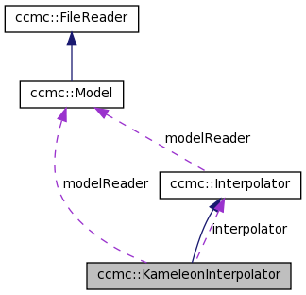
About the library
Kameleon – Interpolator
-Used to access and interpolate the CCMC simulation data
C++ library
CDF storage format
Field line tracing
Derived variable calculation

Slide 6
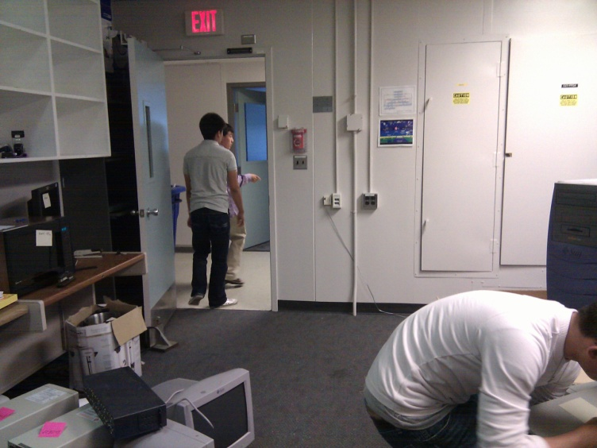
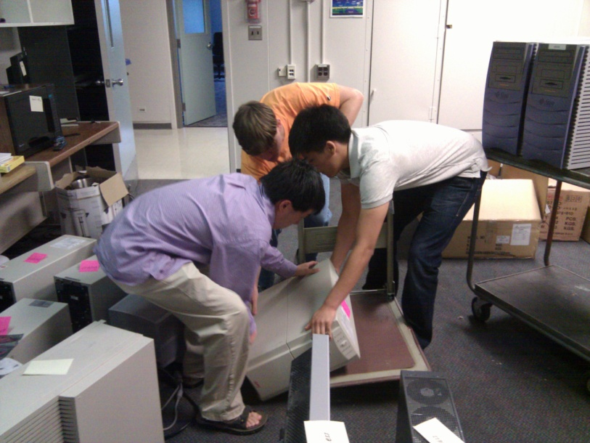
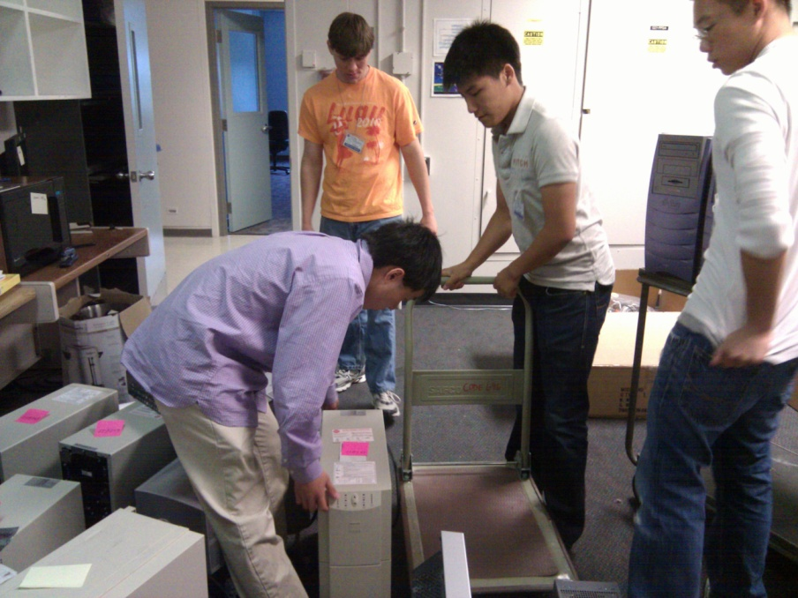
CCMC LAB RELOCATION

Slide 7
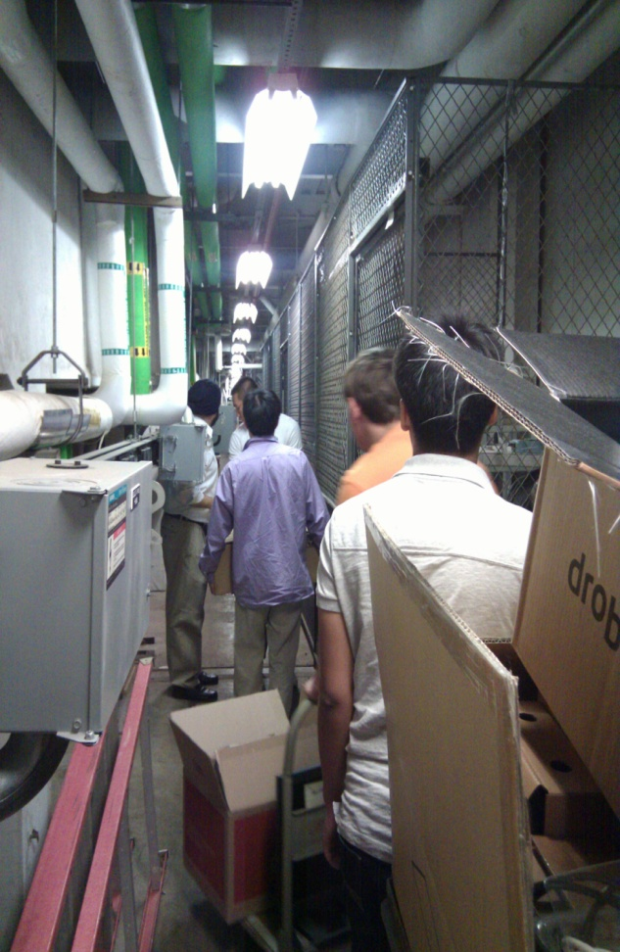
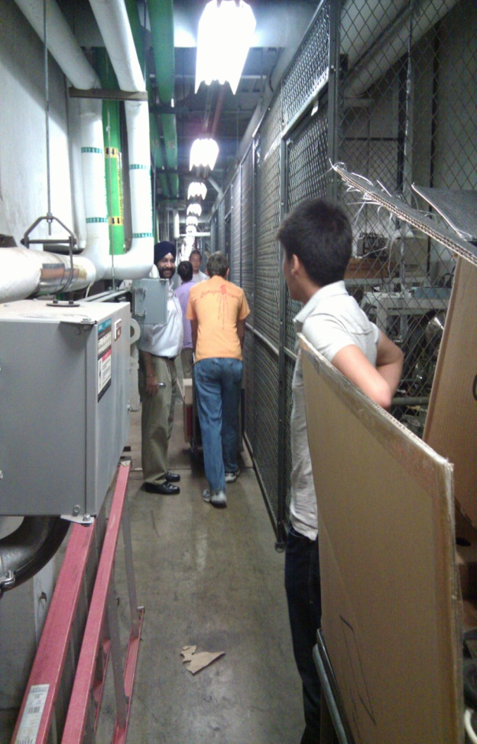
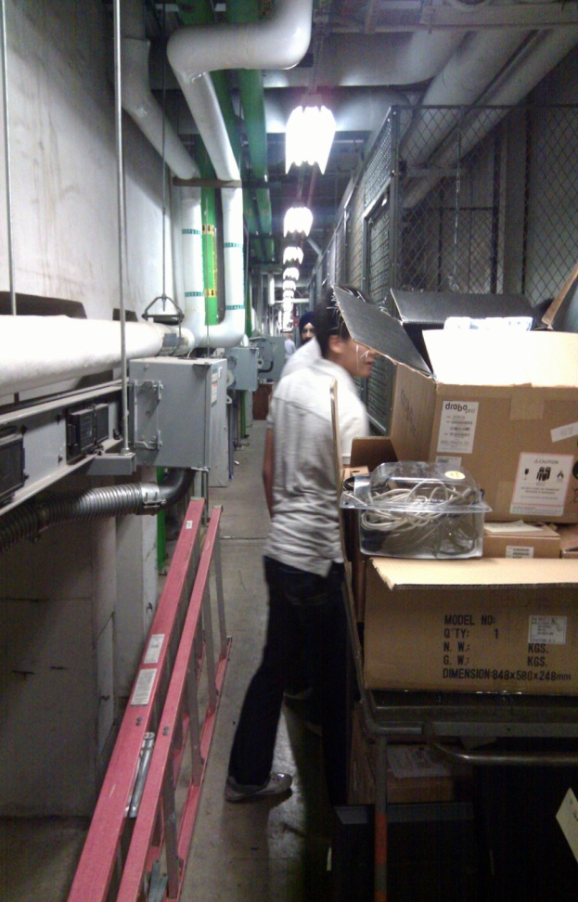
CCMC LAB RELOCATION (Cont.)

Slide 8
Tasks
Created test programs for the model readers
- BATSRUS, OpenGGCM, Kameleon
Created test programs for the field line tracer
- compared field line tracing results
Created a C test program to test the C wrappers
Learned how to time code and compared results with Freddie Romano’s IDL wrapper
Created and modified Makefiles
Compiled and linked external libraries
Programs
BatsrusTest.cpp
KameleonTest.cpp
ShowCoordinates.cpp
TracerTest.cpp
TracerTest1.cpp
TracerTestSimple.cpp
KameleonCTest.c
OpenGGCMTest.cpp

Slide 9


Basic skills I obtained
Makefiles : Includes - Library and header files
Terminal
GCC Compiler
Basics on C
Documentation: Doxygen
Eclipse VS Microsoft Visual
Mac VS PC

Slide 10

Conclusion
More practical programming skills
Capabilities on C++ as well as others
Interest in computer programming
How it feels to be part of NASA Goddard family

Slide 11
The End

